Slide 1
Modelling Human Kinetics and Kinematics during Walking using AI

Slide 2
1. Contact and Human Dynamics from Monocular Video
geometry.stanford.edu/projects/human-dynamics-eccv-2020
A physics based method for inferring 3D human motion from video sequences that takes initial 2D and 3D pose estimates as input.
First estimate ground contact timings with a novel prediction network which is trained without hand-labeled data.
A physics-based trajectory optimization then solves for a physically-plausible motion, based on the inputs.
They demonstrate their method on character animation and pose estimation tasks on dynamic motions of dancing and sports with complex contact patterns.

Slide 3
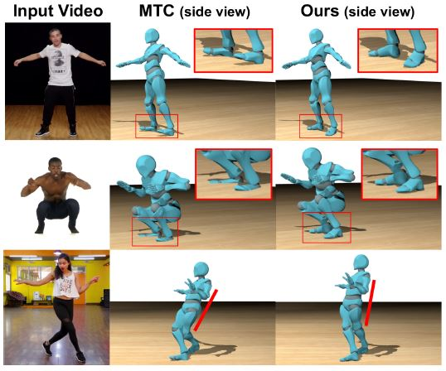
Our contact prediction and physics-based optimization corrects numerous physically
implausible artifacts common in 3D human motion estimations from, e.g., Monocular
Total Capture (MTC) such as foot
foating (top row), foot penetrations (middle),
and unnatural leaning (bottom).

Slide 4
They focus on videos where the human motion itself is much more dynamic, with complex variation in pose and foot contact; they do not consider human-object interaction.
A physics-based trajectory optimization that enforces dynamics on the input motion.
Foot contact timings are estimated in a preprocess, along with other inputs to the optimization

Slide 5
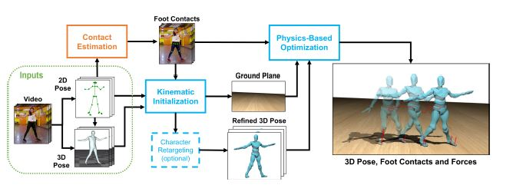
Method overview. Given an input video, our method starts with initial estimates from existing 2D and 3D pose methods. The lower-body 2D joints are used to infer foot contacts (orange box). Our optimization framework contains two parts (blue boxes). Inferred contacts and initial poses are used in a kinematic optimization that refines the 3D full-body motion and fits the ground. These are given to a reduced dimensional physics-based trajectory optimization that applies dynamics.

Slide 6
Physics-Based Trajectory Optimization
They use a temporally varying inertia tensor which allows for changes in mass distribution (swinging arms) and enables estimating the dynamic motions of interest, they add energy terms to match the input kinematic motion and foot contacts, and we add new kinematics constraints for our humanoid skeleton.

Slide 7
Learning to Estimate Contacts
They automatically label contacts in the mocap and then use 2D joint position features from OpenPose as input to their model, rather than image features from the raw rendered video frames. This allows them to train on synthetic data but then apply the model to real inputs.
Dataset: We render these motions (see Figure 5(c)) on their rigged characters with motion blur, randomized camera viewpoint, lighting, and floor texture. For each sequence, we render two views, resulting in over 100k frames of video with labeled contacts and 2D and 3D poses. Finally, we run a 2D pose estimation algorithm, OpenPose, to obtain the 2D skeleton which our model uses as input.

Slide 8
Model and Training:
For 2D pose - For a given time t, our labeling neural network takes as input the 2D poses over a temporal window of duration w centered on the target frame at t. The 2D joint positions over the window are normalized to place the root position of the target frame at (0; 0), resulting in relative position and velocity. We set w = 9 video frames and use the 13 lower-body joint positions as shown in Figure 4.
Additionally, the OpenPose confidence c for each joint position is included as input. Hence, the input to the network is a vector of (x; y; c) values of dimension3 * 13 * 9 = 351. The model outputs four contact labels (left/right toe, left/right heel) for a window of 5 frames centered around the target. At test time, we use majority voting at overlapping predictions to smooth labels across time.
We use a five-layer multilayer perceptron (MLP) (sizes 1024, 512, 128, 32, 20) with ReLU non-linearities [33]. We train the network entirely on our synthetic dataset split 80/10/10 for train/validation/test based on motions per character.

Slide 9
Kinematic Initialization
Their physics-based optimization requires as input a ground plane and initial trajectories for the COM, feet, and inertia tensor. In order to obtain these, we compute an initial 3D full-body motion from video.
1. Monocular Total Capture (MTC) is applied to the input video to
obtain an initial noisy 3D pose estimate for each frame. (MTC accounts for motion through a texture-based refinement step).
2. They initialize a skeleton S(src) containing 28 body joints from the MTC input poses, and then use a kinematic optimization to solve for an optimal root translation and joint angles over time, along with parameters of the ground plane.
3. The full-body output motion of the kinematic optimization is used to extract inputs for the physics optimization.

Slide 10
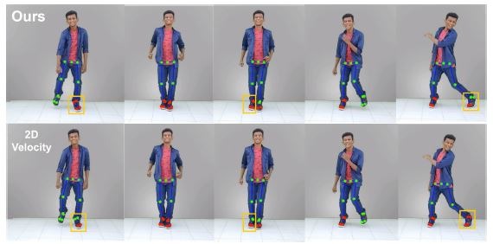
Foot contact estimation on a video using our learned model compared to a 2D velocity heuristic. All visualized joints are used as input to the network which outputs four contact labels (left toes, left heel, right toes, right heel). Red joints are labeled as contacting. Key differences are shown with orange boxes.

Slide 11
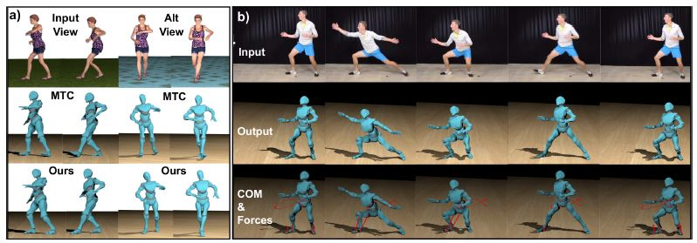
Qualitative results on synthetic and real data. a) results on a synthetic test video with a ground truth alternate view. Two nearby frames are shown for the input video and the alternate view. We fix penetration, floating and leaning prevalent in our method's input from MTC. b) dynamic exercise video (top) and the output full-body motion (middle) and optimized COM trajectory and contact forces (bottom).

Slide 12
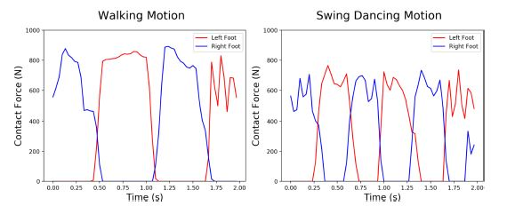
Contact forces from our physics based optimization for a walking and dancing motion. The net contact forces around 1000 N are 140% of the assumed body weight (73 kg), a reasonable estimate compared to prior force plate data.

Slide 13
Quantitative Motion Evaluation
In order to infer the GRFs implied by the kinematic optimization and MTC, they estimate the COM trajectory of the motion using the same mass and distribution as for their physics-based optimization (73 kg). Then approximate the acceleration at each time step and solve for the implied GRFs for all time steps (both in contact and flight).
Kinematics Metrics: They consider three kinematic measures of plausibility. These metrics evaluate accuracy of foot contact measurements. Specifically, given ground truth labels of foot contact we compute instances of foot Floating, Penetration, and Skate for heel and toe joints. Floating is the fraction of foot joints more than 3 cm of the ground when they should be in contact. Penetration is the fraction penetrating the ground more than 3 cm at any time. Skate is the fraction moving more than 2 cm when in contact

Slide 14
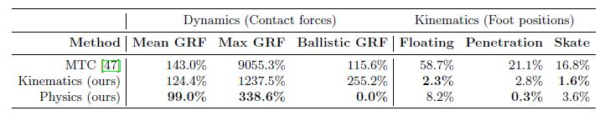
Physical plausibility evaluation on synthetic test set. Mean/Max GRF are contact forces as a proportion of body weight; see text for discussion of plausible values. Ballistic GRF are unexplained forces during flight; smaller values are better.
Foot position metrics measure the percentage of frames containing typical foot contact errors per joint; smaller values are better.

Slide 15
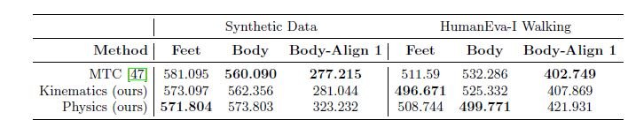
Pose evaluation on synthetic and HumanEva-I walking datasets. They measure mean global per-joint 3D position error (no alignment) for feet and full-body joints. For full-body joints, they also report errors after root alignment on only the first frame of each sequence. They remain competitive while providing key physical improvements.

Slide 16
Limitations
They assume that feet are unoccluded, there is a single ground plane, the subject is not interacting with other objects, and we do not handle contact from other body parts like knees or hands.
Their optimization is expensive. For a 2 second (60 frame) video clip, the physical optimization usually takes from 30 minutes to 1 hour.

Slide 17
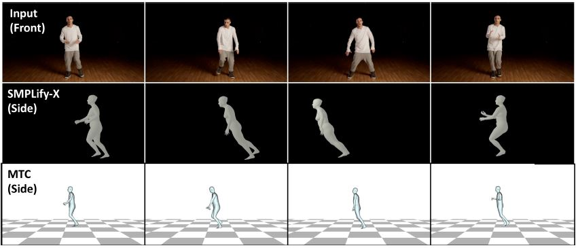
fixed side view is shown from SMPLify-X and Monocular Total Captur(MTC). SMPLify-X gives noisy and inconsistent global motion whereas the tracking refinement of MTC gives smoother results.

Slide 18
2. ‘Two-dimensional video-based analysis of human gait using pose estimation’ by Center for Movement Studies, Kennedy Krieger Institute, Baltimore, MD
https://doi.org/10.1101/2020.07.24.218776
They compared a large set of spatiotemporal and sagittal kinematic gait parameters as measured by OpenPose (a freely available algorithm for video-based human pose estimation) and three-dimensional motion capture from trials where healthy adults walked overground.
They found that OpenPose performed well in estimating many gait parameters (e.g., step time, step length, sagittal hip and knee angles) while some (e.g., double support time, sagittal ankle angles) were less accurate.

Slide 19
Goal of the study
1) compare spatiotemporal and kinematic gait parameters as measured by three-dimensional motion capture and pose estimation via OpenPose, and
2) provide a workflow and suggestions for performing automated human gait analysis from digital video.
OpenPose is a freely available human pose estimation algorithm that uses Part Affinity Fields to detect up to 135 keypoints in images of humans.

Slide 20
Method
Participants: http://bytom.pja.edu.pl/projekty/hm-gpjatk/. (32 healthy participants (10 men and 22 women).
Walking sequences: They analyzed 31 total gait trials (one trial per participant). The mean±SD duration of the video recordings was 5.12±0.73 seconds.
Data Collection: The motion capture cameras (Vicon, MX-T40) recorded three-dimensional marker positions at 100 Hz. Motion was recorded by tracking markers that were placed on the seventh cervical vertebrae (C7), tenth thoracic vertebrae (T10), manubrium, sternum, right upper back and bilaterally on the front and back of the head, shoulder, upper arm, elbow, forearm, wrist (at radius and ulna), middle finger, anterior superior iliac spine (ASIS), posterior superior iliac spine (PSIS), thigh, knee, shank, ankle, heel and toe.

Slide 21
Four video cameras recorded left (camera C1) and right side (camera C3) sagittal plane views and front (camera C4) and back (camera C2) frontal plane views of the walking sequences at 25 Hz. They only analyzed video recordings of left and right side sagittal plane views (cameras C1 and C3).
The digital camera images were RBG files with 960x540 pixel resolution. Motion capture and video recording were synchronized so that the time of every fourth motion capture data point corresponded to each time point of the video frames. Cameras were mounted on tripods and the height was set about 1.3 m. The distance from cameras C1 or C3 to the participants was about 3.2 m.

Slide 22
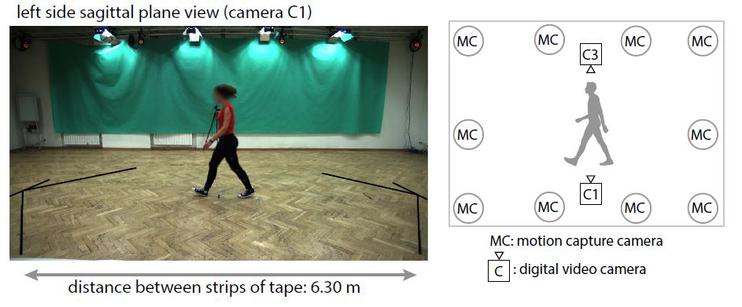

Slide 23
Data processing: We used the following workflow to process sagittal plane video recordings and obtain two-dimensional coordinates of OpenPose key points.
They first analyzed the video recordings with OpenPose using our provided Google Colaboratory notebook and next processed the data using custom written MATLAB software (also provided).
https://github.com/janstenum/GaitAnalysis-PoseEstimation

Slide 24
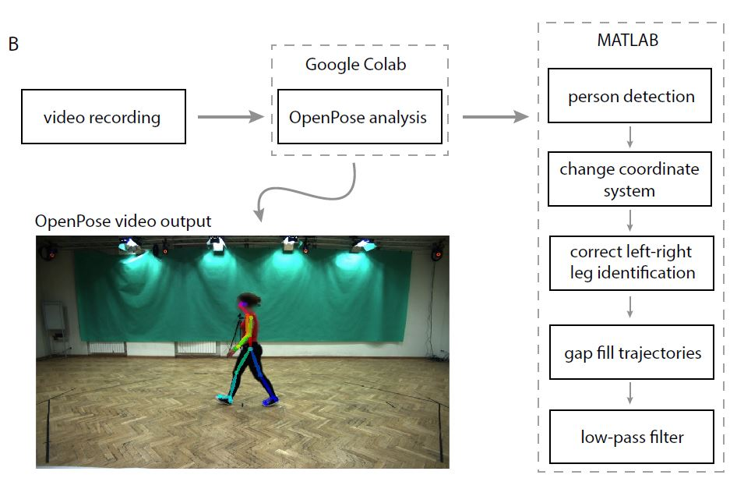

Slide 25
We calculated the following spatiotemporal gait parameters in the motion capture and OpenPose data:
Step time
Stance time
Swing time
Double support time
Step length
Gait speed

Slide 26
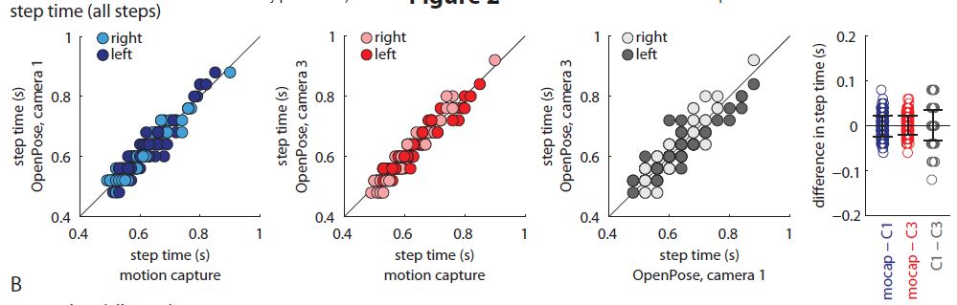

Slide 27
They calculated sagittal plane hip, knee and ankle angles of left and right legs using two-dimensional marker (motion capture) and key point (OpenPose) coordinates.
They created virtual hip markers in the motion capture data by using the midpoints of the ASIS and PSIS markers from each leg. They used the following markers or keypoints to calculate joint angles: virtual hip (motion capture) or hip (OpenPose) and knee (hip angle); hip, knee and ankle (knee angle); knee, ankle, toe (motion capture) or big toe (OpenPose) (ankle angle).

Slide 28
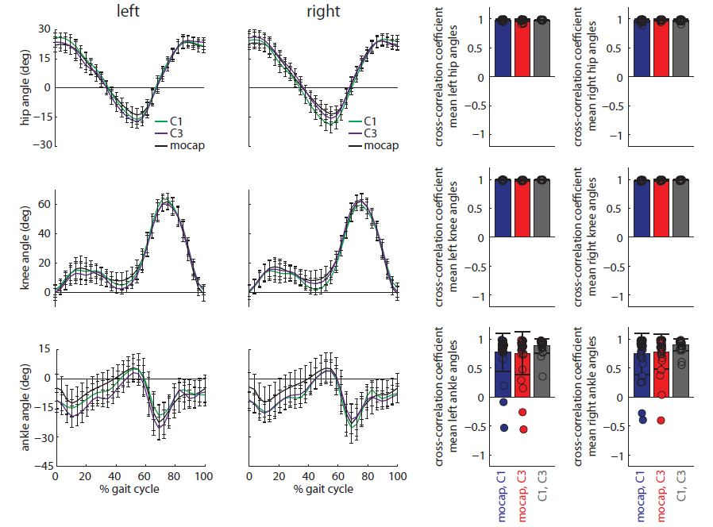

Slide 29
Last, they calculated peak hip flexion and extension, peak knee flexion and extension, and peak ankle dorsiflexion and plantarflexion.

Slide 30
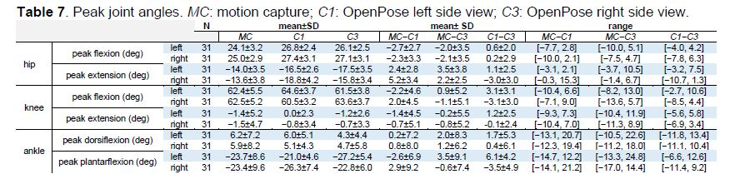

Slide 31
Limitations and suggestions
It is also likely that changes in lighting, clothing, footwear of the participant may affect the ability to track specific keypoints. For example, loose-fitting clothing may introduce more ambiguity into estimations of hip or knee keypoints.
They expect that recording methods with higher frame rates (e.g., the slow-motion video recording feature available on most smartphones), faster shutter speeds, and wider fields of view may improve the accuracy of video-based gait analyses.

Slide 32
3. Deep Learning for Monitoring of Human Gait: A Review
The modalities for capturing the gait data are grouped according to the sensing technology: video sequences, wearable sensors, and floor sensors, as well as the publicly available datasets.
The established artificial neural network architectures for deep learning are reviewed for each group, and their performance are compared with particular emphasis on the spatiotemporal character of gait data and the motivation for multi-sensor, multi-modality fusion.

Slide 33
Video Sequence
Gait recognition based on VS in literature is sub-divided into skeleton model-based and skeleton model-free categories.
The model-free approach is based on extracting gait from VS using feature engineering. Here, deep learning is utilized to automatically extract gait features from VS, which maximizes the use of data variability and eliminates the dependence on handcrafting.
Most of the available model-free processed data is represented by Gait Energy Image (GEI), maps of optical flow and silhouettes or Chrono-Gait Images (CGI). These representations, extracted from VS, can capture both spatial and temporal information.

Slide 34
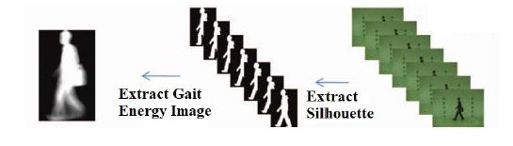
From right to left: video sequence, silhouette images and EGI image

Slide 35
Video sequence databases
CMU Motion of Body (MoBo), USF Gait Based Human ID Challenge, CASIA, OU-ISIR treadmill, OU-ISIR and TUM-GAID.

Slide 36
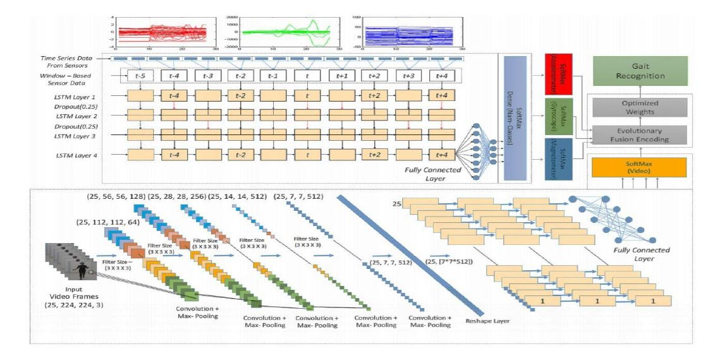
MULTI-MODALITY GAIT SENSOR FUSION

Slide 37
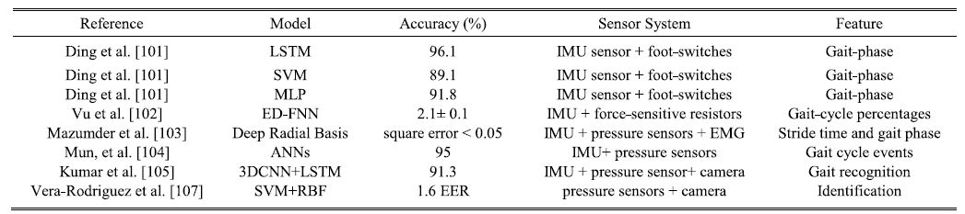
RESULTS FOR GAIT RECOGNITION FROM MULTI-MODALITY SENSOR FUSION
EER: equal error rates; RBF: radial basis function; EMG: electromyography

Slide 38
4. 3D Tracking of Human Motion Using Visual Skeletonization and Stereoscopic Vision
doi: 10.3389/fbioe.2020.00181
This paper aimed at validating a two-cameras OpenPose-based markerless system for gait analysis, considering its accuracy relative to three factors: cameras’ relative distance, gait direction and video resolution.

Slide 39
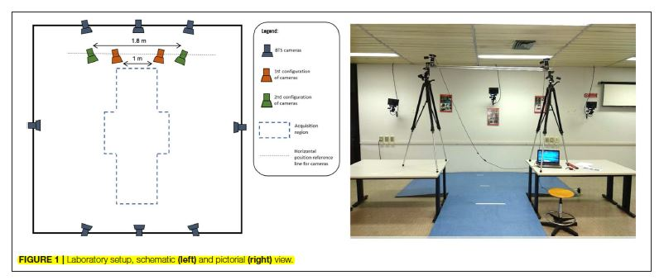
Lab setup

Slide 40
The effect of three factors potentially influencing the accuracy of the proposed system were considered:
1. Cameras’ relative distance.
2. Gait direction, straight or diagonal, defined by means of visual
references positioned along the path.
3. Video resolution: high (1,312 × 736 pixel), and standard (640 × 480 pixel). Both resolutions were obtained by scaling the camera native resolution with a cubic interpolation, this way they avoided the repetition of recording sessions.

Slide 41
Measurement System and Equipment
Two full-HD webcams with a native image resolution of 1920 × 1080 pixels and a 1/2.7” CMOS sensor were used. Cameras acquired images at 30Hz, with contrast and brightness automatically selected by the software provided by the manufacturer.
A stereophotogrammetric motion analyser equipped with eight infrared cameras sampling at 100Hz was used as reference measurement system.

Slide 42
Procedures
Cameras calibration was performed within Matlab by means of the Camera Calibration Toolbox. The Toolbox returns an estimate of the cameras internal and external parameters.
Acquisition of two video recordings, a and b using the cameras of the stereoscopic system. Each recording allowed to collect between four and five steps.
Simultaneous recording using the reference, marker-based optical system. Twenty-four reflective markers were placed on the subject. This marker set was adapted from standard protocols used in clinical gait analysis and was designed to match the skeletal configuration of OpenPose. wrists, elbows, knees and ankles joint centers were located at the midpoint (average) of medial and lateral markers. Hip joint centers were computed using regression equations as prompted by the International Society of Biomechanics standards.

Slide 43
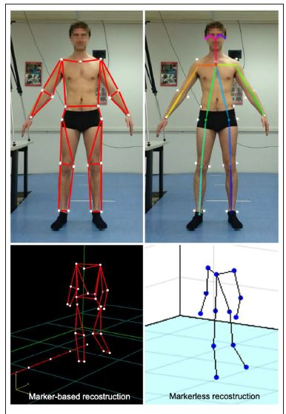
Stick diagrams as returned by the marker-based optical system (top, left) and OpenPose model (top, right); corresponding 3D reconstruction of the skeletal structures during walking (bottom).

Slide 44
4. Video processing within OpenPose to extract the skeleton S of a (single) subject in each video recording (Sa and Sb).
5. Synchronization of the two videos (see paragraph Data Synchronization and Spatial Alignment).
6. Triangulation of the skeletons Sa and Sb using the calibration outcome (step 1) to obtain the three-dimensional coordinates of the joints and alignment between coordinate system of step 4.
7. Computation of gait parameters (see paragraph Target Parameters Computation) based on the three-dimensional coordinates obtained.
8. Evaluation of the OpenPose accuracy for each single test according to the metrics defined in the following paragraph.
9. Evaluation of the dependence of accuracy from the factors’ levels using a 3 × 2 Analysis of Variance.

Slide 45
Data Processing
A set of 18 2D keypoints coordinates for body pose estimation (in pixels) are returned by OpenPose from video images.
This operation was performed using the Matlab Computer Vision System Toolbox.
The resulting output was the 3D skeletal model of the subject.

Slide 46
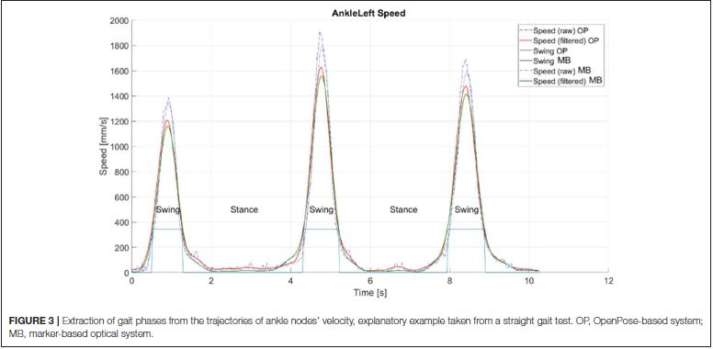
Target Parameters Computation

Slide 47
Thank You!

